Slide 1
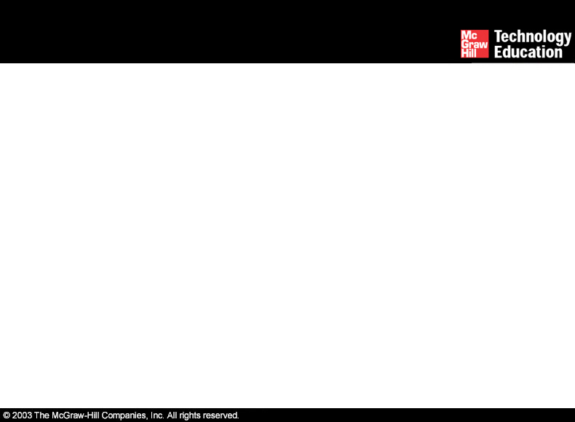
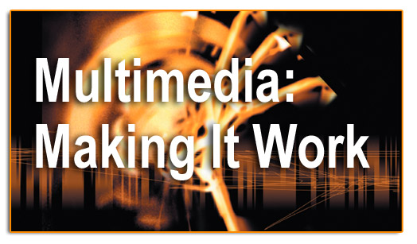
Lesson 4-Text

Slide 2
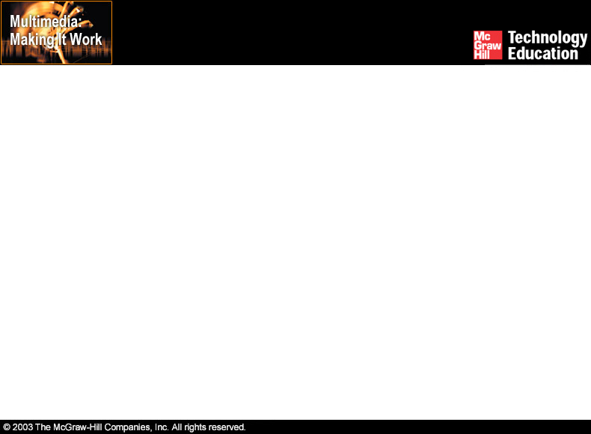
Overview
Importance of text in a multimedia presentation.
Understanding fonts and typefaces.
Using text elements in a multimedia presentation.
Computers and text.
Font editing and design tools.
Multimedia and hypertext.

Slide 3
Importance of Text in a Multimedia Presentation
Words and symbols in any form, spoken or written, are the most common means of communication.
Text is a vital element of multimedia menus, navigation systems, and content.

Slide 4
Importance of Text in a Multimedia Presentation
Factors affecting legibility of text:
  Size.
  Background and foreground color.
  Style.
  Leading.

Slide 5
Understanding Fonts and Typefaces
A ‘typeface’ is a family of graphic characters that usually includes many type sizes and styles.
A ‘font’ is a collection of characters of a single size and style belonging to a particular typeface family.

Slide 6
Understanding Fonts and Typefaces
The study of fonts and typefaces includes the following:
  Font styles.
  Font sizes.
  Cases.
  Serif versus Sans Serif.

Slide 7
Font Styles
Font styles include:
  Boldface
  Italic
  Underlining
  Outlining

Slide 8
Font Sizes
Font size is measured in points.
Character metrics are the general measurements applied to individual characters.
Kerning is the spacing between character pairs.
Leading is the space between lines.

Slide 9
Cases
A capitalized letter is referred to as 'uppercase', while a small letter is referred to as 'lowercase.'
Placing an uppercase letter in the middle of a word is referred to as intercap.

Slide 10
Serif Versus Sans Serif
Serif is the little decoration at the end of a letter stroke.
Serif fonts are used for body text.
Sans serif fonts do not have a serif at the end of a letter stroke.
These fonts are used for headlines and bold statements.

Slide 11
Using Text Elements in a Multimedia Presentation
The text elements used in multimedia are:
  Menus for navigation.
  Interactive buttons.
  Fields for reading.
  HTML documents.
  Symbols and icons.

Slide 12
Menus for Navigation
A user navigates through content using a menu.
A simple menu consists of a text list of topics.

Slide 13
Interactive Buttons
A button is a clickable object that executes a command when activated.
Users can create their own buttons from bitmaps and graphics.
The design and labeling of the buttons should be treated as an industrial art project.

Slide 14
Fields for Reading
Reading a hard copy is easier and faster than reading from the computer screen.
A document can be printed in one of two orientations - portrait or landscape.

Slide 15
Fields for Reading
The taller-than-wide orientation used for printing documents is called portrait.
The wider-than-tall orientation that is normal to monitors is called landscape.

Slide 16
HTML Documents
HTML stands for Hypertext Markup Language.
It is the standard document format used for Web pages.
HTML documents are marked using tags.

Slide 17
HTML Documents
An advanced form of HTML is DHTML.
DHTML stands for Dynamic Hypertext Markup Language.
DHTML uses Cascading Style Sheets (CSS).

Slide 18
HTML Documents
Some of the commonly used tags are:
  The <B> tag for making text bold faced.
  The <OL> tag for creating an ordered list.
  The <IMG> tag for inserting images.

Slide 19
Symbols and Icons
Symbols are concentrated text in the form of stand-alone graphic constructs.
They are used to convey meaningful messages.
Symbols used to convey human emotions are called emoticons.
Icons are symbolic representations of objects and processes.

Slide 20
Using Text Elements in a Multimedia Presentation
Anti-aliased text must be used when a gentle and blended look for titles and headlines is needed.
Ideas and concepts can be highlighted by making the text bold or by emphasizing text.
A pleasant look can be created by experimenting with different font faces, sizes, leadings, and kerning.

Slide 21
Computers and Text
The font wars.
Character sets.

Slide 22
The Font Wars
PostScript
TrueType

Slide 23
PostScript
PostScript is a method of describing an image in terms of mathematical constructs.
PostScript characters are scalable and can be drawn much faster.
The two types of PostScript fonts are Type 3 and Type 1.
Adobe developed Adobe Type Manager for displaying PostScript fonts on both Macintosh and Windows.

Slide 24
TrueType
Apple and Microsoft developed the TrueType methodology.
TrueType is a system of scalable outline fonts, and can draw characters at low resolution.

Slide 25
Character Sets
The American Standard Code for Information Interchange (ASCII) is a 7-bit coding system.
The extended character set is commonly filled with ANSI standard characters.
The ISO-Latin-1 character set is used while programming the text of HTML pages.

Slide 26
Character Sets
Unicode is a 16-bit architecture for multilingual text and character encoding.
The shared symbols of each character set are unified into collections of symbols called scripts.

Slide 27
Character Sets
Mapping across platforms:
  Fonts and characters are not cross-platform compatible.
  They must be mapped to the other machine using font substitution.

Slide 28
Font Editing and Design Tools
Macromedia Fontographer.
Creating attractive texts.

Slide 29
Macromedia Fontographer
Fontographer is a specialized graphics editor.
It is compatible with both Macintosh and Windows platform.
It can be used to develop PostScript, TrueType, and bitmapped fonts.
It can also modify existing typefaces and incorporate PostScript artwork.

Slide 30
Creating Attractive Texts
Applications that are used to enhance texts and images include:
    Adobe Photoshop
    TypeStyler
    COOL 3D
    HotTEXT
    TypeCaster

Slide 31
Multimedia and Hypertext
Multimedia.
Hypertext system.
Using hypertext systems.
Searching for words.
Hypermedia structures.
Hypertext tools.

Slide 32
Multimedia
Multimedia is defined as the combination of text, graphics, and audio elements into a single presentation.
When the user assumes control over the presentation, it is called interactive multimedia.
Interactive multimedia becomes hypermedia when a structure of linked elements is provided to the user for navigation and interaction.

Slide 33
Hypertext System
Hypertext is defined as the organized cross-linking of words, images, and other Web elements.
A system in which words are keyed or indexed to other words is referred to as a hypertext system.
A hypertext system enables the user to navigate through text in a non-linear way.

Slide 34
Using Hypertext Systems
Information management and hypertext programs present electronic text, images, and other elements in a database fashion.
Software robots visit Web pages and index entire Web sites.

Slide 35
Using Hypertext Systems
Hypertext databases make use of proprietary indexing systems.
Server-based hypertext and database engines are widely available.

Slide 36
Searching for Words
Typical methods for word searching in hypermedia systems are:
    Categorical search
    Word relationship
    Adjacency
    Alternates
    Association

Slide 37
Searching for Words
Typical methods for word searching in hypermedia systems are (continued):
    Negation
    Truncation
    Intermediate words
    Frequency

Slide 38
Hypermedia Structures
Links.
Nodes.
Anchors.
Navigating hypermedia structures.

Slide 39
Links
Links are connections between conceptual elements.
Links are the navigation pathways and menus.

Slide 40
Nodes
Nodes are accessible topics, documents, messages, and content elements.
Nodes and links form the backbone of a knowledge access system.

Slide 41
Anchors
Anchor is defined as the reference from one document to another document, image, sound, or file on the Web.
The source node linked to the anchor is referred to as a link anchor.
The destination node linked to the anchor is referred to as a link end.

Slide 42
Navigating Hypermedia Structures
The simplest way to navigate hypermedia structures is via buttons.
Location markers must be provided to make navigation user-friendly.

Slide 43
Hypertext Tools
Two functions common to most hypermedia text management systems are building (authoring) and reading.

Slide 44
Hypertext Tools
The functions of ‘builder’ are:
  Creating links.
  Identifying nodes.
  Generating an index of words.

Slide 45
Hypertext Tools
Hypertext systems are used for:
  Electronic publishing and reference works.
  Technical documentation.
  Educational courseware.
  Interactive kiosks.
  Electronic catalogs.

Slide 46
Summary
Text is one of the most important elements of multimedia.
The standard document format used for Web pages is called HTML.
Multimedia is the combination of text, graphics, and audio elements into a single presentation.
A hypertext system enables the user to navigate through text in a non-linear way.

